Slide 1
Further MATLAB Programming – Make Your Code Efficient and Robust
Louise Brown, Yijie (Amy) Zheng

Slide 2
Course Outline
Day 1 am: 0. Introduction to version control, git and github
1. The MATLAB Language and Desktop Environment
Day 1 pm: 2. Algorithm Design in MATLAB
Day 2 am: 3. Test and Verification of MATLAB Code
Day 2 pm: 4. Debugging and Improving Performance

Slide 3
Version Control
It’s all gone horribly wrong!
Does this look familiar?
TestCode.m
TestCode_data_set1.m
TestCode_data_set1_v2.m
TestCode_data_set1_v2_with_output.m
Use version control, eg Git, Subversion or Mercurial

Slide 4
Git Workflow
It’s all gone horribly wrong!
5
8
10
Discontinued branch
Branch
2
3
6
7
1
4
9
Trunk
T1
Tag
T2
Tags can correspond to code producing results for research papers

Slide 5
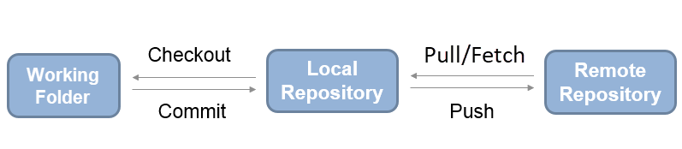
Git Workflow
e.g. GitHub
Use git in MATLAB:
https://uk.mathworks.com/help/matlab/matlab_prog/use-git-in-matlab.html

Slide 6
Fork and Clone Course Materials
louisepb/Further-MATLAB-Student-Materials on GitHub
Fork the repo into your own GitHub account
Clone the repo into BootCampFiles folder on your local machine
Run setupPath.m
Notes:
Try
Might want different configurations for different computers, no of screens etc

Slide 7
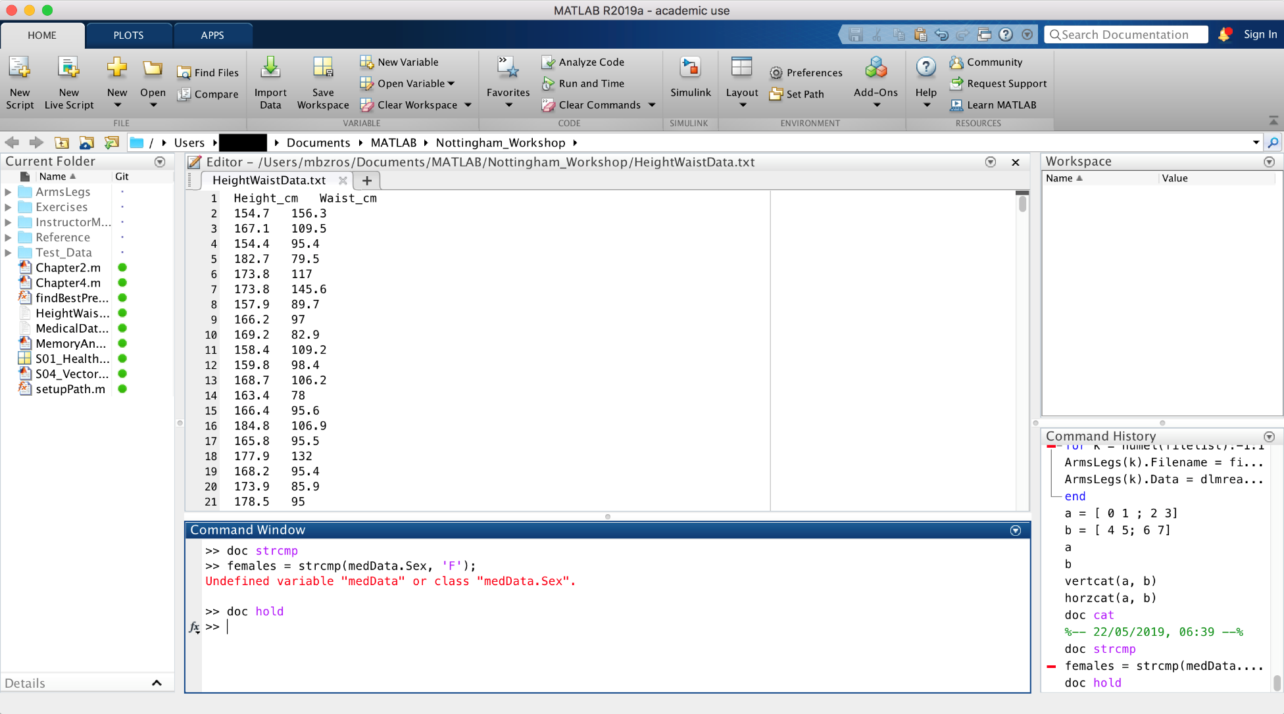
The MATLAB Desktop
Notes:
Try
Might want different configurations for different computers, no of screens etc

Slide 8
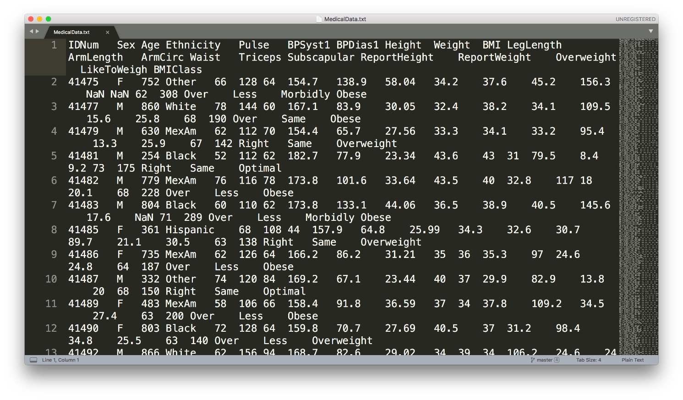
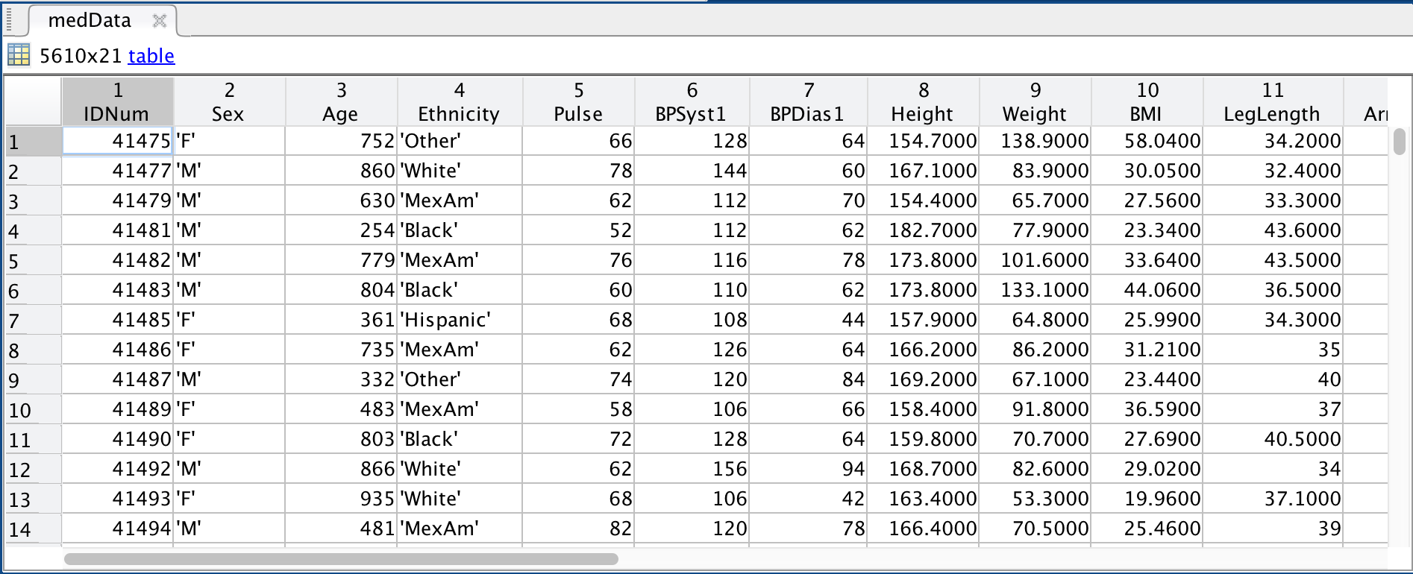
Heterogeneous data
doc readtable

Slide 9
Tables
Useful for heterogenous, column oriented or tabular data
Variables can have different data types
All columns must have the same number of rows
Not restricted to column vectors (eg could have matrix but number of rows condition still applies
Create table from workspace data using the table function:
TableName = table(var1, var2, var3,… );
or by using readtable to load a data set:
TableName = readtable(‘data.dat’);
Notes:
load patients
whos to show data
PatientData = table( Gender, Age, Height, Weight );
AllPatientData = readtable(‘patients.dat’);

Slide 10
Indexing into Tables
Address column data using dot notation:
PatientData.Gender % Accesses the whole column
Then normal indexing for the data type:
PatientData.Gender(10) % Accesses data in column
Access particular rows and columns using subscript notation:
PatientData(1:3, :);
ans =
Gender Age Height Weight
________ ___ ______ ______
'Male' 38 71 176
'Male' 43 69 163
'Female' 38 64 131
Notes:
PatientData(1:3, : )

Slide 11
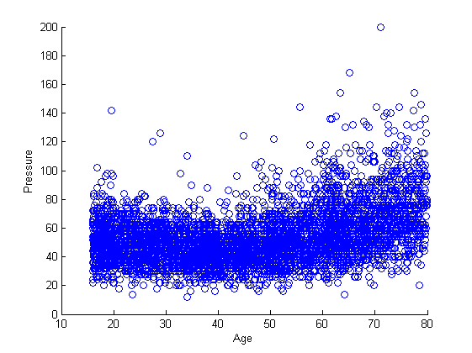
Plotting vectors
figure % new figure
% basic plot
scatter(medData.Age, medData.BPDiff)
xlabel(‘Age’)
ylabel(‘Pressure’)

Slide 12
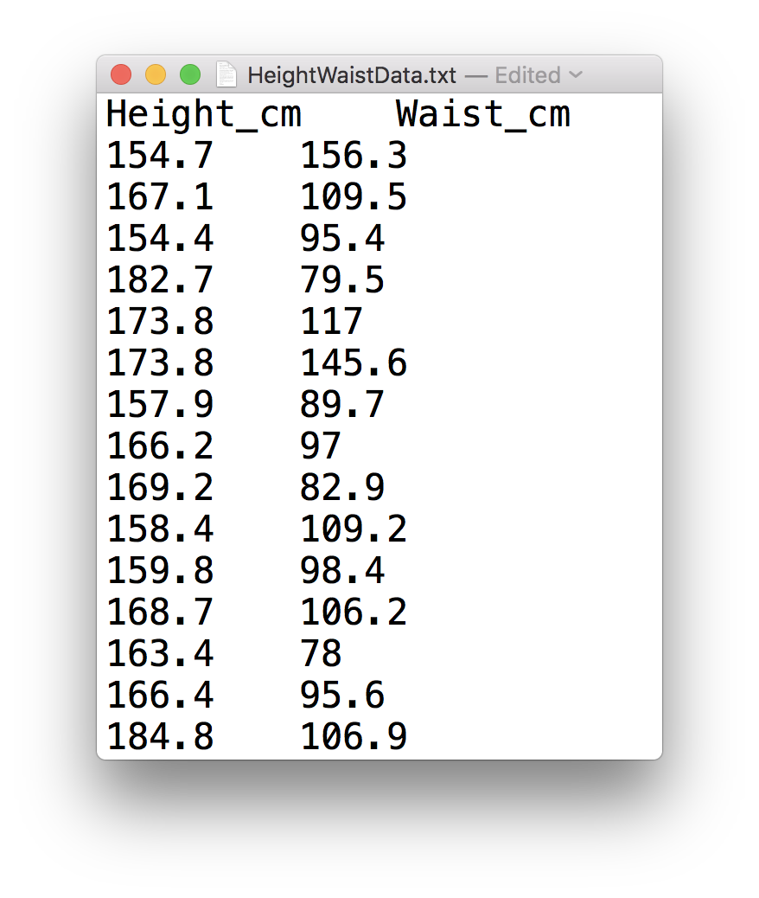
Low-Level file I/O
fileID = fopen(‘HeightWaistData.txt’);
dataFormat = ‘%f %f’;
heightWaistData = textscan(fileID, dataFormat, ...
‘HeaderLines’, 1, ‘Delimiter’, ‘\t’);
fclose(fileID);

Slide 13
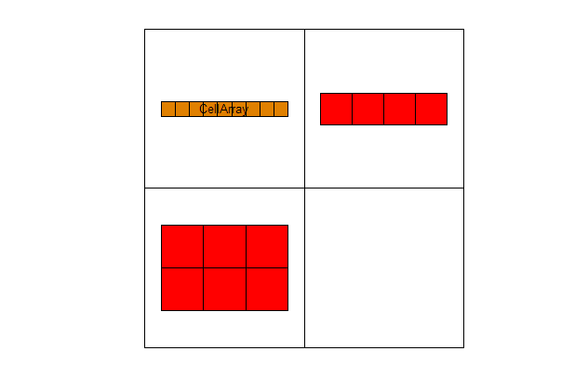
Cell Arrays
Store different types of data
Accessed by index
Particularly useful for storing different length strings
Can be used for importing spreadsheet data with different data types in the cells
>> A = ‘CellArray‘
>> B = 1:4;
>> C = [1:3,2:4];
>> CellArray = {A B; C []}
Curly brackets to specify cell array
Must specify empty elements or MATLAB will generate error
Visualise array using cellplot command
celldisp displays cell array contents
Notes:
If store strings in ordinary array stored as arrays of chars -> strings in each row must be consistent length
Specify empty elements or will complain about being inconsistent

Slide 14
Accessing Cell Array Data
Note difference between use of () and {}:
Use CellArray(m,n) to display data structure
>> CellArray(1,2)
ans =
[1x4 double]
Use CellArray{m,n} to display contents of the cell
>> CellArray{1,2}
ans =
1 2 3 4
To access individual elements within a cell use ():
>> % second element of array at cell position (1,2)
>> CellArray{1,2}(2)
ans =
2

Slide 15
Extending Cell Arrays
Note that array is padded to keep rows and columns consistent
Add more cells using the {} notation:
>> CellArray{3,3} = 1:4
CellArray =
'CellArray' [1x4 double] []
[2x3 double] [] []
[] [] [1x4 double]
Preallocate cell arrays using the cell function:
cell(10,10) creates an empty 10x10 cell array
Notes:
Exercise 11.2 p 44

Slide 16
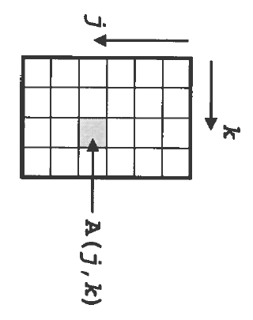
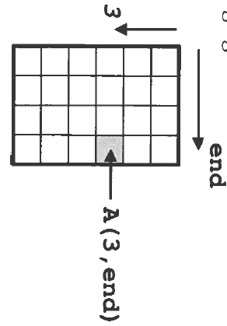
Accessing Data in Arrays
>> x = A(j,k)
Row Column
>> x = A(3,end)

Slide 17
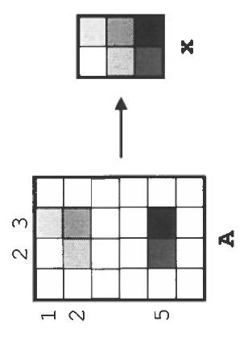
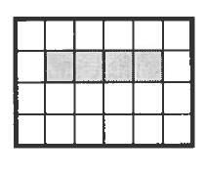
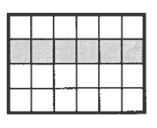
Accessing Multiple Elements
Use a vector of indices to reference multiple elements:
>> x = A([1,2,5],[2,3]);
Use colon notation to indicate a range of rows and/or columns:
>> x = A(2:5, 3);
>> x = A(1:6, 3);
>> x = A(1:end, 3);
>> x = A(:, 3);
all extract the entire third column.

Slide 18
Dealing with Missing Data
Bad or missing data will be imported as NaN
This can be removed using logical indexing
Gives logical vector with value of 1 where data is NaN
badData = isnan(Height);
CleanHeight = Age(~badData);
Use ~ (not) so that good data has value of 1 in logical vector
Notes:
Use Age.mat to demonstrate
Exercise 12.1, p48

Slide 19
Structures
Related data grouped together in fields which are referred to by name
alternate field names and contents
Create by:
>> cars = struct( 'year', 2010, 'colour','red','mpg', 35)
cars =
year: 2010
colour: 'red'
mpg: 35
Or:
>> cars.year = 2010;
>> cars.colour = ‘red’;
>> cars.mpg = 35;
Notes:
Show creation of structure and how it appears in workspace
Typically if find passing same group of variables around functions should probably be in structure
Stress that even if don’t use structures themselves, need to understand how to use as used in built-in functions

Slide 20
Arrays of Structures
Create arrays of structures either by adding another structure:
cars(2) = newcar;
Or by assigning new elements directly:
>> cars(3).year = 2012;
>> cars(3).colour = ‘blue’;
>> cars(3)
ans =
year: 2012
colour: ‘blue
mpg: []
Any unassigned fields will be present in the structure but will be empty
 | year | colour | mpg
cars(1) | 2010 | red | 35
cars(2) | 2008 | black | 42
cars(3) | 2012 | blue
Notes:
Can add completed structure, or elements of new ones
Demonstrate addition of extra fields
NB fields must be in same order for structures to be considered the same
Field names can’t have spaces

Slide 21
Combining Matrices
Larger arrays can be built up from smaller ones:
>> A = [1:5;5:9]
A =
1 2 3 4 5
5 6 7 8 9
>> B = [1:2:9;2:2:10]
B =
1 3 5 7 9
2 4 6 8 10
Square brackets [] are the concatenation operator
Delimiters:
, or space – Arrays go side by side
; - Arrays go one above the other
Note that the dimensions of arrays being joined must be consistent.
5 columns in both
>> D = [A;B]
D =
1 2 3 4 5
5 6 7 8 9
1 3 5 7 9
2 4 6 8 10
2 rows in both
>> E = [A, B]
E =
1 2 3 4 5 1 3 5 7 9
5 6 7 8 9 2 4 6 8 10
Notes:
Effectively same as the way that vectors are stacked to make matrices
Could also have put side by side: [A B]

Slide 22
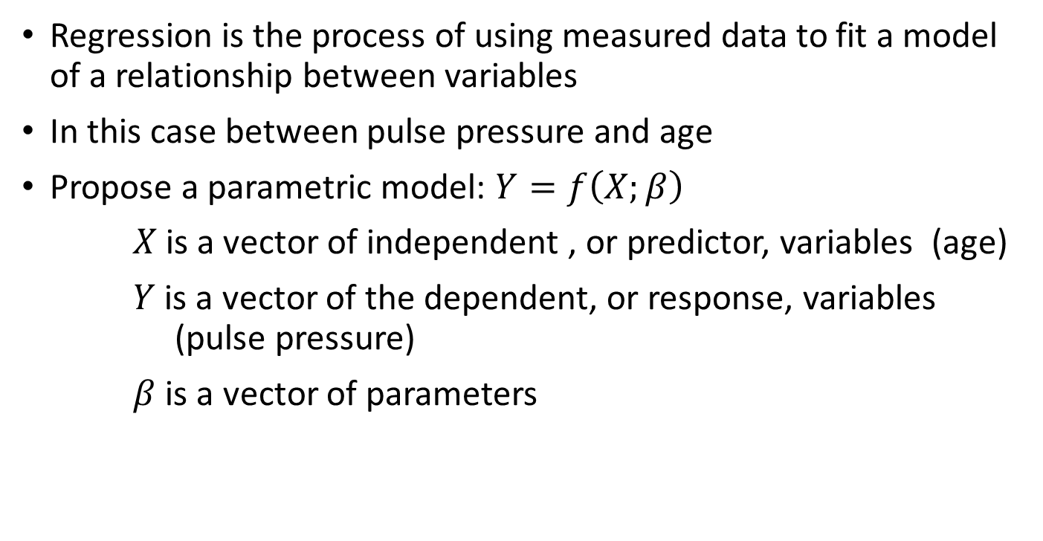
Linear Regression Models
Regression is the process of using measured data to fit a model of a relationship between variables
In this case between pulse pressure and age
Propose a parametric model: $Y=f\left(X;β\right)$
$X$is a vector of independent , or predictor, variables (age)
$Y$ is a vector of the dependent, or response, variables (pulse pressure)
$β$ is a vector of parameters

Slide 23
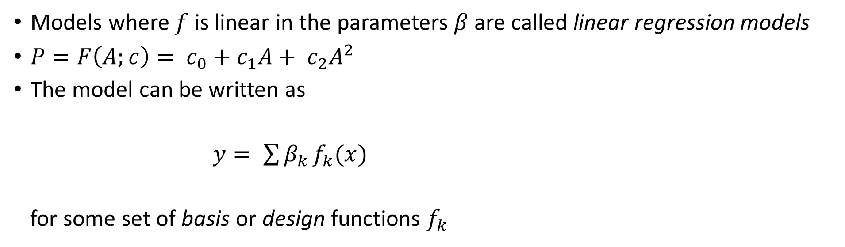
Linear Regression Models
Models where $f$ is linear in the parameters $β$ are called linear regression models
$P=F\left(A;c\right)= c_{0}+c_{1}A+ c_{2}A^{2}$
The model can be written as
$y= \sum{β_{k }f_{k}(x)}$
for some set of basis or design functions $f_{k}$
Response
Predictor
Model parameters
Design functions

Slide 24

Matrix Equations
Fitting n measured data points gives a system of n linear equations with m unknown model parameters (c_{j})
$$y_{1} = c_{1}f_{1}\left(x_{1}\right)+ c_{2}f_{2}\left(x_{1}\right)+ …+c_{m}f_{m}(x_{1})$$
$$y_{2} = c_{1}f_{1}\left(x_{2}\right)+ c_{2}f_{2}\left(x_{2}\right)+ …+c_{m}f_{m}(x_{2})$$
$$⋮$$
$$y_{n} = c_{1}f_{1}\left(x_{n}\right)+ c_{2}f_{2}\left(x_{n}\right)+ …+c_{m}f_{m}(x_{n})$$
Using matrix algebra, this system can be written in matrix-vector form as:
$$y_{1} = f_{1}\left(x_{1}\right) f_{2}\left(x_{1}\right) …{ f}_{m}\left(x_{1}\right){ c}_{1}$$
$$y_{2} = f_{1}\left(x_{2}\right) f_{2}\left(x_{2}\right) …{ f}_{m}\left(x_{2}\right){ c}_{2}$$
$$⋮$$
$$⋮$$
$$⋮$$
$$⋱$$
$$⋮$$
$$⋮$$
$$y_{n} = f_{1}\left(x_{n}\right) f_{2}\left(x_{n}\right) …{ f}_{m}\left(x_{n}\right){ c}_{m}$$

Slide 25
Slash and Backslash
Matrix multiplication is not commutative (generally AB ≠ BA)
AX = B and XA = B represent different systems of equations for X
MATLAB uses / and \ to distinguish between these:
>> X = B/A represents “solve the system XA = B”, while
>> X = B\A represents “solve the system AX = B”

Slide 26
Anonymous Functions
Anonymous functions are local functions only available until the workspace is cleared. They are called anonymous because they do not refer to a named function.
Fnhandle = @ (input arguments) functioncode;
Shows function handle being created
Can be saved in .mat file using load and save commands
f = @(x,y) sin(x) + y
>> f(pi/6, 0.5)
ans =
1
Notes:
Bit like an inline function
Show creating polynomial poly = @(x) 4*x.^2 + 3.*x + 7

Slide 27
Anonymous Functions
Anonymous function creating function handle
modelFun = @(c, x1, x2) c(1)+c(2)*x1+c(3)*x2c(4)*x1.^2 + ...
c(5)*x2.^2 + c(6)*x1.*x2;
Mathematical notation
f(x1, x2) = c(1) +c(2)*x1 +c(3)*x2 + c(4)*x1.^2 + ...
c(5)*x2.^2 + c(6)*x1*x2
$f( x_{1}$,$x_{2})=c_{1}+ c_{2}x_{1}+c_{3}x_{2}+ c_{4}x_{1}^{2}+ c_{5}x_{2}^{2}+ c_{6}x_{1}x_{2}$

Slide 28
Making Grids
The meshgrid function converts vectors of points into matrices that can represent a grid of points in the x-y plane
>> x = -2:4; % 1 x 7 vector
>> y = 0:5; % 1 x 6 vector
>> [X,Y] = meshgrid(x,y)
X =
-2 -1 0 1 2 3 4
-2 -1 0 1 2 3 4
-2 -1 0 1 2 3 4
-2 -1 0 1 2 3 4
-2 -1 0 1 2 3 4
-2 -1 0 1 2 3 4
Y =
0 0 0 0 0 0 0
1 1 1 1 1 1 1
2 2 2 2 2 2 2
3 3 3 3 3 3 3
4 4 4 4 4 4 4
5 5 5 5 5 5 5
42 points in grid of points in the x,y plan
x coordinate at each grid point
y coordinate at each grid point

Slide 29
Creating a Function
Must have function declaration on line 1 of file
Must be the same as the filename – fitQuadModel.m
Output arguments
Input arguments
function [modelCoeffs, fh] = fitQuadModel(X, y, showplot)
% FITQUADMODEL Fits a quadratic model to the response data
% using the columns of X as regressors. X has one or two
% columns; y is a vector with the same number of rows as X.
Notes:
Built up basics to be able to write code
Need the tools to be able to write well constructed programs
Good practice to include H1 line to show input/output arguments
Dummy arguments are basically templates

Slide 30
Software Testing
Please take a look at this blog before the session tomorrow:
A Brief Introduction to Software Testing

Slide 31

Software Testing
How do you test your code?
How do you know it gives the right answers?
Add your ideas to the padlet:

Slide 32
Debugging and Improving Performance
Diagnosing problems
Identifying common errors
Evaluation of code performance
Vectorisation techniques
Managing memory effectively

Slide 33
Preallocation of Memory
Efficient matrix and array operations rely on data being located together in a contiguous block of memory addresses
Create a dummy version of a variable of appropriate size
>> A = zeros(m,n)
Subsequent operations then overwrite the zeros with the required values
Assigning the last element of an array first creates an array of the appropriate size
>> x(8) = 3
x =
0 0 0 0 0 0 0 3

Slide 34
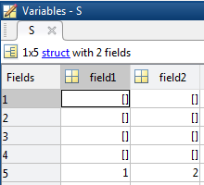
Preallocating Cells and Structures
Cell arrays and structure arrays act as containers for various types of data
>> c = cell(1,5)
The cell command preallocates the container
c
Define the last element in a structure array
>> S(5).field1 = 1;
>> S(5).field2 = 2;

Slide 35
In-Place Optimisation
In-place optimisation saves on memory by reusing an input variable for output
y = 2*x + 3;
x = 2*x + 3; Saves memory by assigning back into variable x and execution time for allocating memory
Functions
....
x = myfun(x)
....
Regular Function
In-Place Optimisation
Function y = myfun(x)
y = 2*x + 3;
Function x = myfun(x)
x = 2*x + 3;
x
myfun
y
x
myfun

Slide 36
MATLAB Profiler with Flame Graph video

Slide 37

Feedback
We really value your feedback, which you can provide by completing this short survey​
​
Course date as 06/06/2024​
Course code as GSTML3

Slide 38
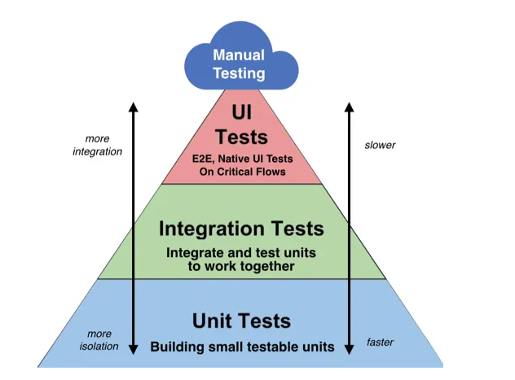
Different levels of software testing
Figure source: Lawrence Tan “Unit Tests, UI Tests, Integration Tests & End-To-End Tests” Medium, September 19, 2019

Slide 39
Unit Testing
Test individual code units in isolation from the rest of the system
Test that each unit works as intended
Identify bugs early in the development process
Makes it easier to refactor code
Facilitates collaboration
May be manual or automated
Automation frameworks are used to perform multiple tests.

Slide 40
How would we test this function works correctly?
function [distance] = DistBetweenPoints(p1x, p1y, p2x, p2y)
% Function to calculate distance between 2 points
% Input: x and y coordinates of two points - can be integer or floating
% point. Can be vectors of points
% Output: The distance between the points
if ( (p2x-p1x) == 0 && (p2y-p1y) == 0)
error("Single point");
end
distance = sqrt( (p2x -p1x).^2 + (p2y-p1y).^2);
end

Slide 41
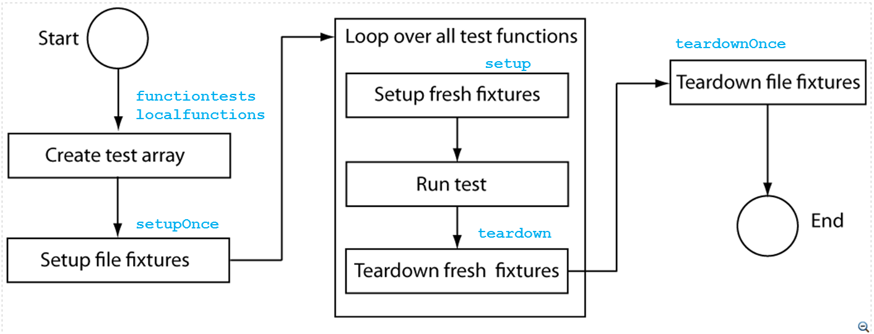
Task Execution

Slide 42
Main test function
Function tests = testFunction
tests = functiontests( localfunctions() );
End
function test_func1(testcase)
…
end
function test_func2(testcase)
…
end
Assembles cell array of function handles for local functions in current file

Slide 43
Feedback
We really value your feedback, which you can provide by completing this short survey​
​
Course date as 06/06/2024​
Course code as GSTML3

